Slide 1

Title: "Real Estate Pricing Analysis"
Name: Ms.Irshad Shaikh-Junior Data Scientist
Submission Date:13/02/2025

Slide 2
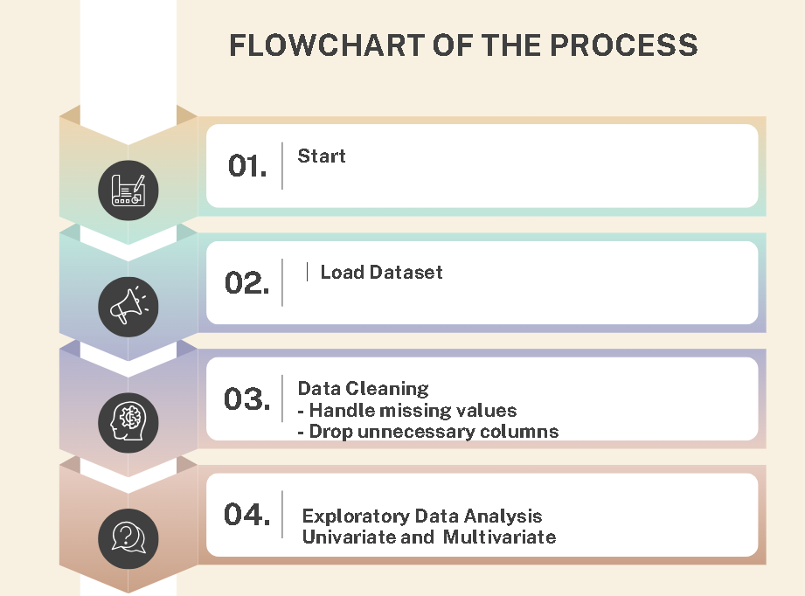
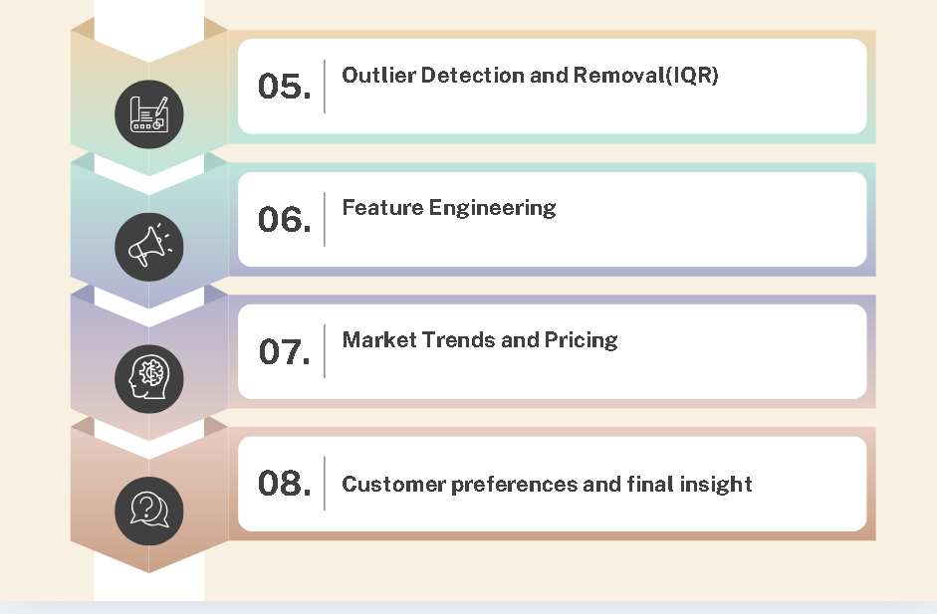
Project Overview
Objective: Understanding key factors influencing house prices
Importance: Helps buyers, sellers, and investors make better decisions
Key Questions:What factors drive house prices?
How do features like garages, pools, and renovations impact value?

Slide 3
Dataset Overview
Data Source: Housing dataset
Initial Shape: 81 columns, 1460 rows
Key Features: SalePrice, GrLivArea, GarageCars, etc.
Missing Values Found: Yes, in Alley, PoolQC, etc.

Slide 4
Data Cleaning
Workflow Breakdown:
Phase 1: Data Acquisition:
Loading datasets into Python.
Initial exploration using .info() and .head().
Phase 2: Data Wrangling:
Handling missing values and duplicates.
Outlier detection.
Phase 3: Data Analysis:
Statistical analysis and skewness correction.
Visualizations (e.g., heatmaps, scatter plots).

Slide 5
Exploratory Data Analysis (EDA)
Univariate Analysis:
SalePrice is right-skewed (Most houses are affordable, few are luxury)
GrLivArea shows most houses are 1000-2500 sqft.
Multivariate Analysis:
Strong Correlations: OverallQual, GrLivArea, GarageCars → High SalePrice
Neighborhood affects pricing significantly

Slide 6
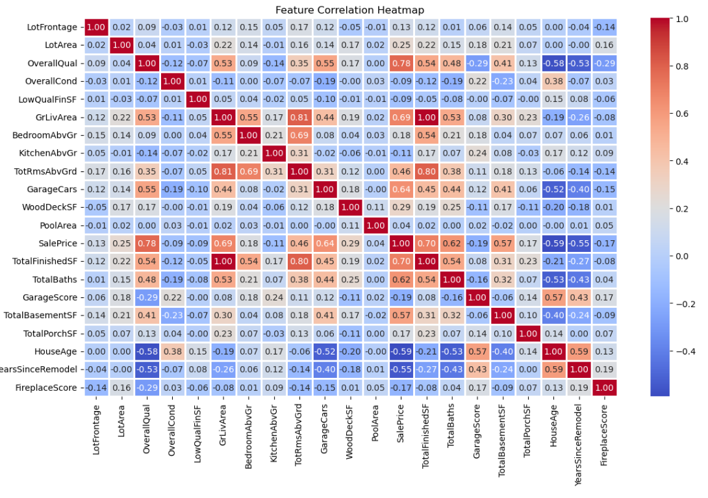
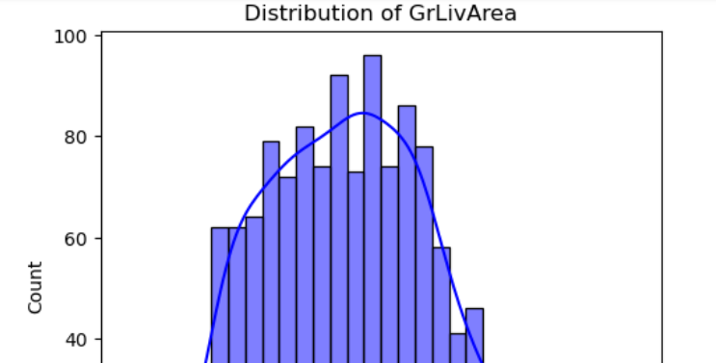
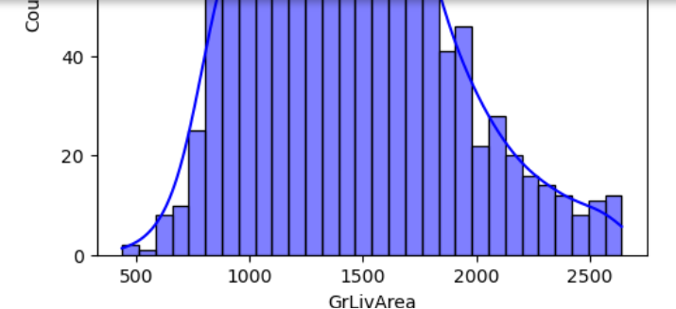
Exploratory Data Analysis (EDA)
Univariate Analysis: Multivariate Analysis:

Slide 7
Outlier Detection & Removal)
Boxplots revealed extreme values in: SalePrice, GrLivArea, TotalBasementSF
IQR method applied to remove extreme values
After removal: More balanced dataset

Slide 8
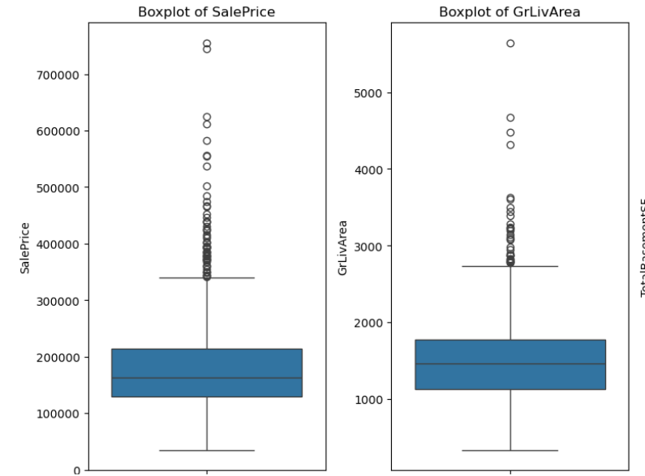
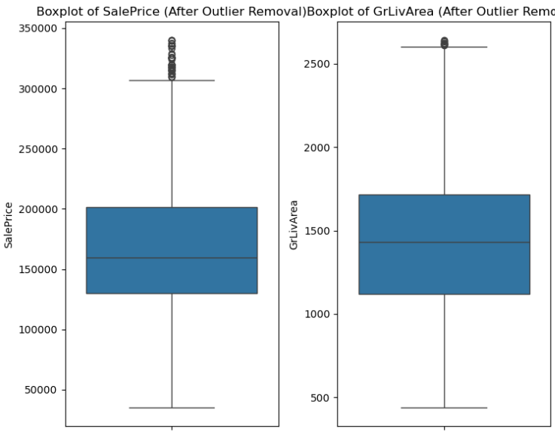
Outlier Detection & Removal) Before After

Slide 9
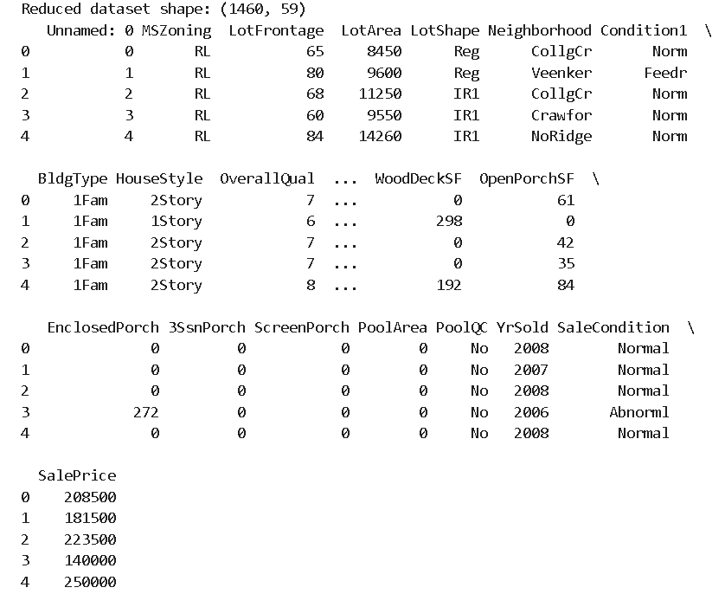
Feature Engineering
Created New Features:
TotalFinishedSF = 1stFlrSF + 2ndFlrSF
TotalBaths = FullBath + 0.5 × HalfBath + BsmtFullBath
+ 0.5 × BsmtHalfBath
GarageScore = GarageCars ×
(2024 - GarageYrBlt)
Dropped Unnecessary Columns
after feature engineering

Slide 10
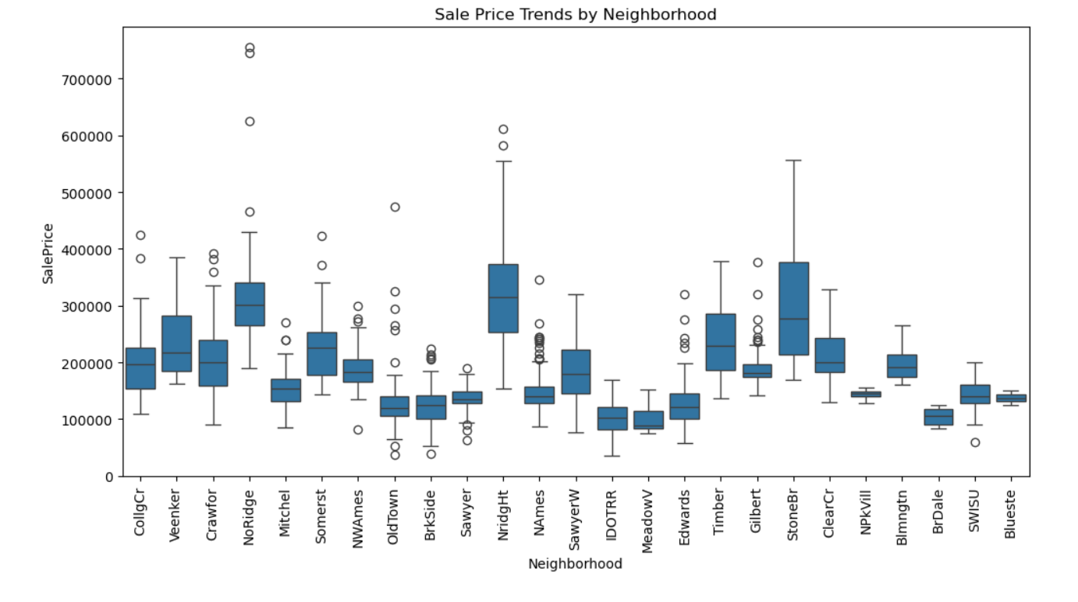
Market Trends & Historical Pricing
Trends Over Time:
Newer houses sell for higher price.
Renovated homes have better value
Neighborhood Impact:
"StoneBr", "NridgHt", "NoRidge" are most expensive areas

Slide 11
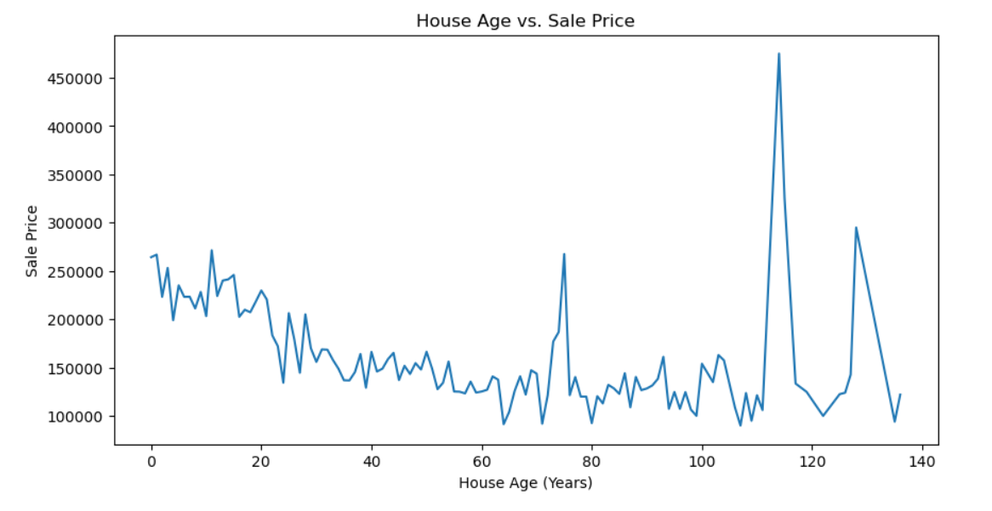
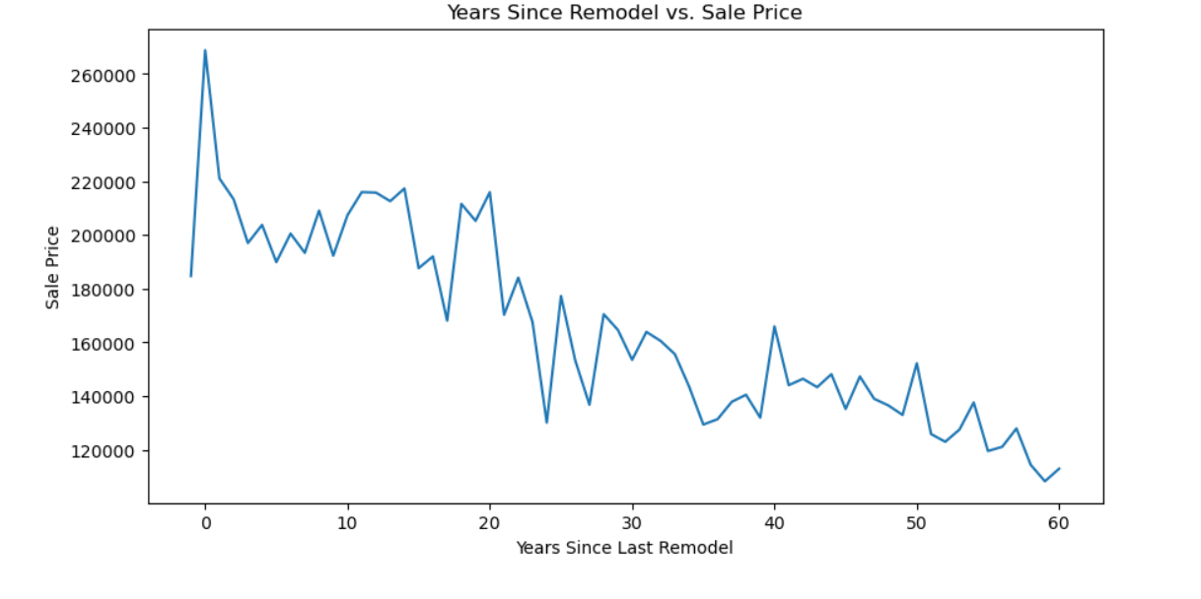
Market Trends & Historical Pricing

Slide 12
Customer Preferences & Amenities Impact
Findings:
Garages: 2-3 car garages increase house price
Swimming Pools: Higher prices, but rare
Fireplaces: Add value, but not necessary for high price
Porches: Add curb appeal but don’t significantly affect price

Slide 13
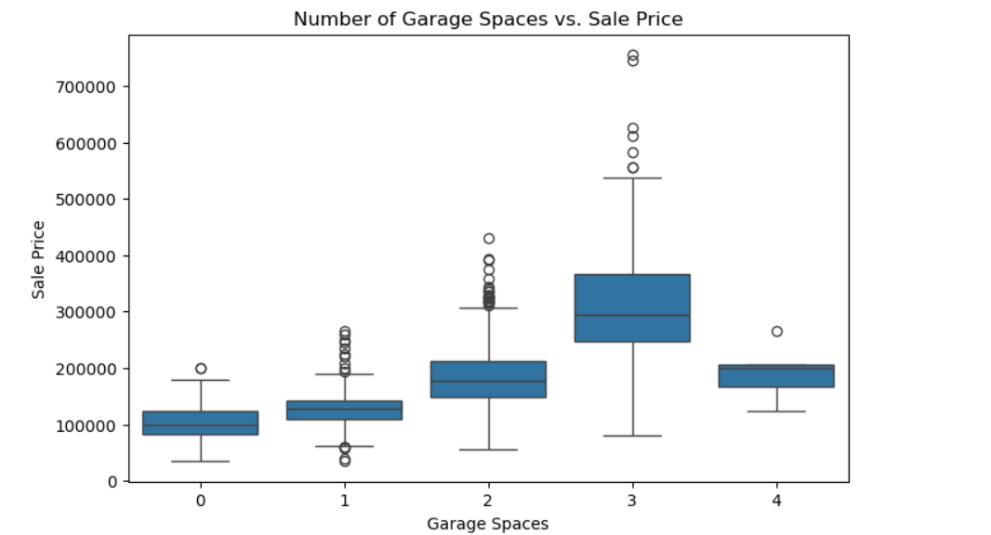
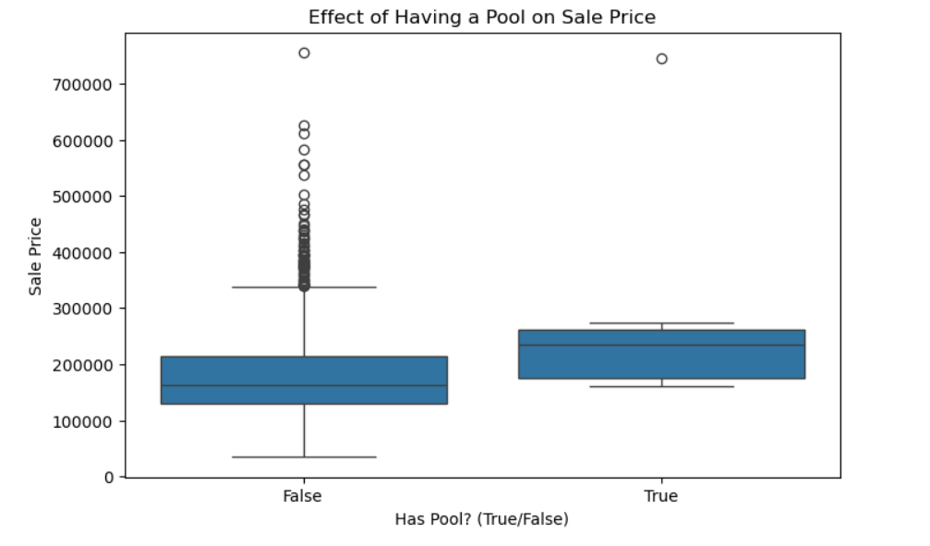
Customer Preferences & Amenities Impact

Slide 14
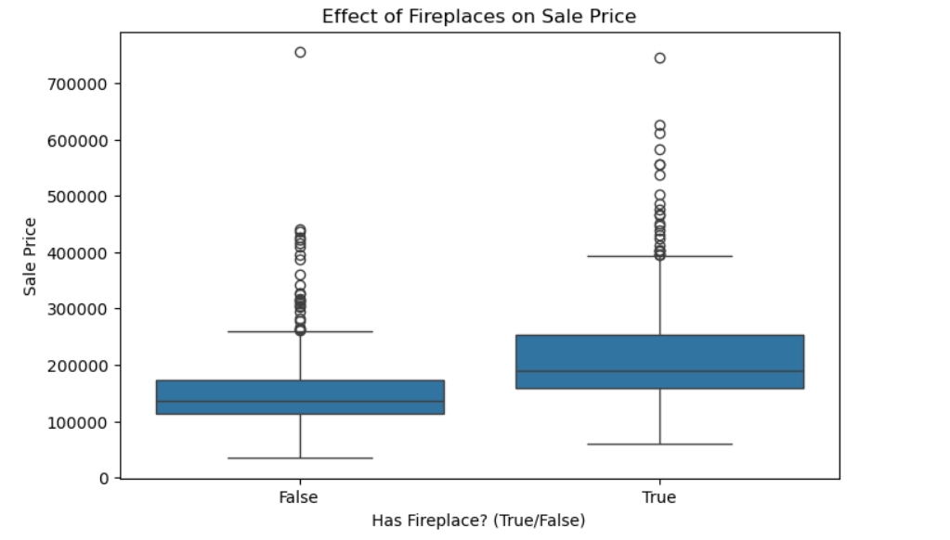
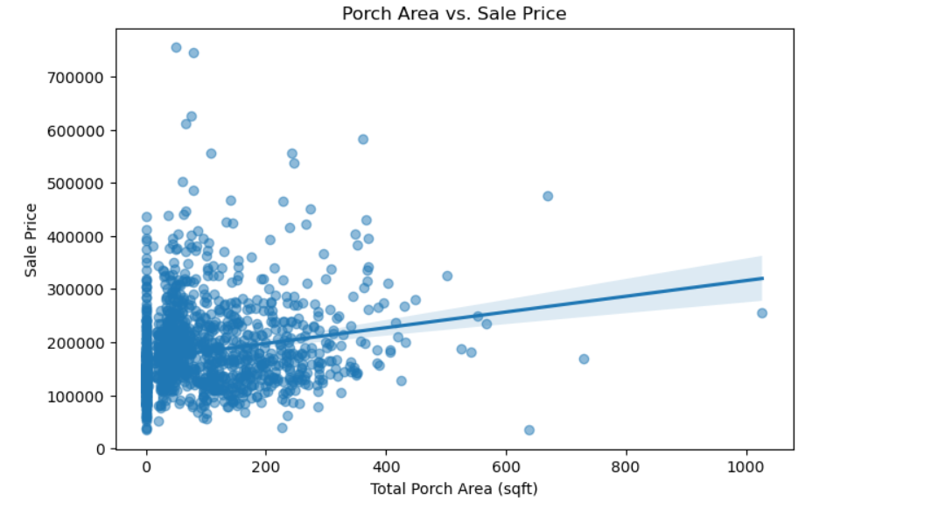
Customer Preferences & Amenities Impact

Slide 15
Final Insights & Recommendations
Key Takeaways:
Top 3 Factors Affecting Price: OverallQual, GrLivArea, GarageCars
Renovated houses sell at better prices
Luxury homes are not always large; location matters
📌 Future Recommendations:
Consider adding external market data like interest rates
Predict future housing prices using machine learning

Slide 16
References
Sources:
Dataset-Housing_Data.xlsx
Libraries: Pandas, NumPy, Seaborn, Matplotlib.
Links or citations.
https://www.geeksforgeeks.org/data-wrangling-in-python/
https://seaborn.pydata.org/index.html
https://stackoverflow.com

Slide 17



